Slide 1
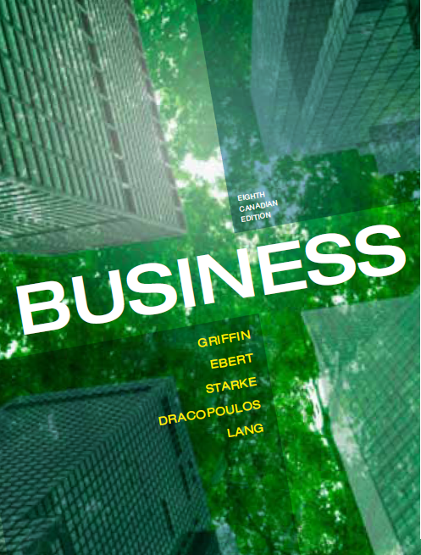
CHAPTER 4
UNDERSTANDING ENTREPRENEURSHIP, SMALL
BUSINESS, AND NEW VENTURE CREATION
Copyright © 2014 Pearson Canada Inc.
4-<number>

Slide 2
Learning Objectives
Explain the meaning of and interrelationship among the terms small business, new venture creation, and entrepreneurship.
Describe the role of small and new businesses in the Canadian economy.
Explain the entrepreneurial process and describe its three key elements.
Describe three alternative strategies for becoming a business owner: starting a business, buying an existing business and buying a franchise.
Copyright © 2014 Pearson Canada Inc.
4-<number>
Notes:
These learning objectives are based upon those at the beginning of the chapter. For a review of learning objectives, see the summary at the end of the chapter, as well as the list of key terms.

Slide 3
Learning Objectives
5. Describe four forms of legal organization for a business and discuss the advantages and disadvantages of each.
6. Identify four key reasons for success in small businesses and four key reasons for failure.
Copyright © 2014 Pearson Canada Inc.
4-<number>
Notes:
These learning objectives are based upon those at the beginning of the chapter. For a review of learning objectives, see the summary at the end of the chapter, as well as the list of key terms.

Slide 4
Small Business, New Venture Creation, and Entrepreneurship
(LO 4-1)
Small Business
  An owner-managed business with fewer than 100 employees
    definitions vary; some statistics do not include unincorporated businesses with one owner and no employees EXAMPLES?
New Venture
  Recently formed commercial organization opened within last 12 months sells goods or services EXAMPLES?
Copyright © 2014 Pearson Canada Inc.
4-<number>
Notes:
Learning Objective: 4-1
Activities
Questions for Analysis: #1

Slide 5
Small Business, New Venture Creation, and Entrepreneurship
(LO 4-1)
Entrepreneurship
  process of identifying an opportunity in the marketplace and capitalizing on it ARE YOU ENTREPRENEURIAL?
Entrepreneur
  person who recognizes and seizes opportunities
  research shows a lack of consensus-are they born or do they just react to circumstances? DO YOU KNOW ONE?
  https://www.youtube.com/watch?v=cDnHtnhFHFU Steve Blank on entrepreneurs
Intrapreneur
  creates something new within an existing large organization GOOGLE THEM
Copyright © 2014 Pearson Canada Inc.
4-<number>
Notes:
Learning Objective: 4-1
Table 4.1
Case 4-1

Slide 6
Small and New Businesses in the Canadian Economy
(LO 4-2)
Role of Small Business
  98% of all employer businesses in Canada are small (fewer than 100 employees)
  Main source of job creation
  Leaders in innovation and new technology
Copyright © 2014 Pearson Canada Inc.
4-<number>
Notes:
4
4
Learning Objective: 4-2
Note
“New business” excludes businesses without employees. May have been operated by owner alone for many years prior to hiring employees.
Activities
Questions for Analysis #2

Slide 7
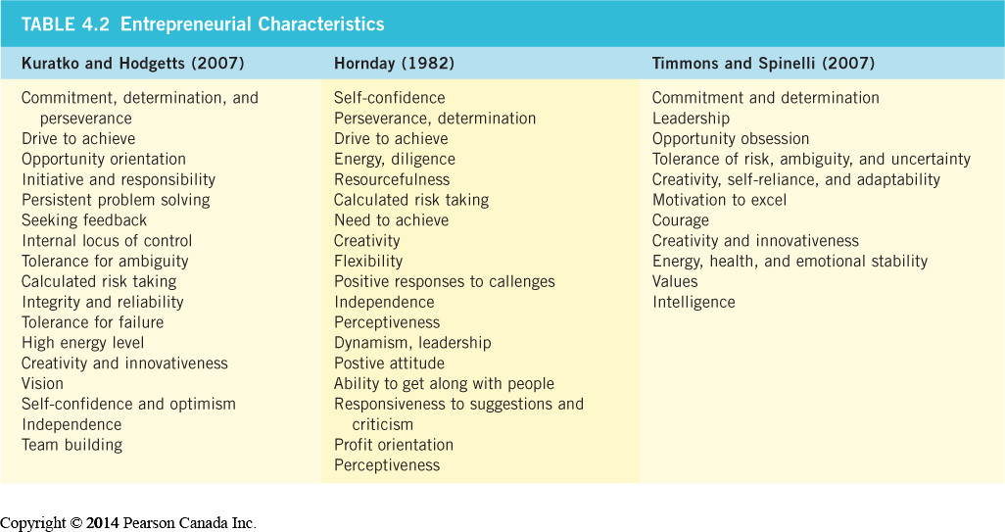
The Entrepreneurial Process
(LO 4-3)
Copyright © 2014 Pearson Canada Inc.
4-<number>
Notes:
8
8
Learning Objective: 4-3
Figure 4.2
Case 4-2
Activities
Have students discuss the difference between entrepreneurship and simply owning a business. Can they list high profile business owners who they think are entrepreneurial? What about Bill Gates or Donald Trump? Can they think of others?
Have students examine the list of characteristics to identify the similarities in the 3 lists.
Questions for Analysis #3
Application Exercise #3

Slide 8
The Entrepreneurial Process
(LO 4-3)
Identifying Opportunities
Generating ideas
Screening ideas
  Idea adds or creates value
  Idea provides a competitive advantage
  Idea is marketable and financially viable
  Idea has low exit costs
Developing the opportunity
Copyright © 2014 Pearson Canada Inc.
4-<number>
Notes:
8
8
Learning Objective: 4-3
Table 4.3
Activities
Application Exercise #1

Slide 9
IN-CLASS ACTIVITY
Research an entrepreneur you admire. What can you find out about how they identify new opportunities?
If you’re an entrepreneur, do you follow the entrepreneurial process?
© 2014 Pearson Education Ltd.
4-<number>

Slide 10
The Entrepreneurial Process
(LO 4-3)
Accessing Resources
Bootstrapping
  doing more with less
  preferably use external resources
Financial Resources
  debt
  equity
Other resources
  Business Development Bank of Canada (BDC)
  incubators
  the Internet
  WHAT RESOURCES WILL YOU USE TO FUND YOUR BIZ?
Copyright © 2014 Pearson Canada Inc.
4-<number>
Notes:
Learning Objective: 4-3
Notes
Sometimes entrepreneurs share ownership to gain access to resources
Resources may come from partners, employees, customers, suppliers, professionals, consultants, government agencies, lenders, shareholders, venture capitalists
Necessity of a team depends on Size and scope of venture and personal competencies

Slide 11
The Entrepreneurial Process
(LO 4-3)
Assessing the “Fit”
Entrepreneur–Opportunity Fit
  is it possible?
Opportunity–Resources Fit
  can required resources be acquired?
Entrepreneur–Resources Fit
  capacity to meet requirements?
Copyright © 2014 Pearson Canada Inc.
4-<number>
Notes:
Learning Objective: 4-3
Notes
This slide refers back to the Entrepreneurial Process diagram. One can only go forward if there is a fit between the 3 elements.
Activities
Questions for Analysis #5

Slide 12
After the Start-Up
(LO 4-4)
Starting Up a Small Business
Buying an already existing business
Taking over a family business
Buying a franchise
Copyright © 2014 Pearson Canada Inc.
4-<number>
Notes:
Learning Objective: 4-4

Slide 13
After the Start-Up
(LO 4-4)
Buying an Existing Business
Cons
  uncertainty about the financial health of the company
  location may be poor
  the pricing strategy may need to be revisited
  may have developed a poor reputation
Pros
  established clientele
  ease of financing
  experienced employees
  established lines of credit and supply
  less risky than starting from scratch
Copyright © 2014 Pearson Canada Inc.
4-<number>
Notes:
16
16
Learning Objective: 4-4

Slide 14
After the Start-Up
(LO 4-4)
Family-Owned Business Challenges
https://www.theglobeandmail.com/business/small-business/managing/article-when-family-business-gets-ugly/
https://business.financialpost.com/news/retail-marketing/leon-vs-leon-inside-the-brutal-battle-tearing-apart-canadas-furniture-family
Ongoing Management
  which family members have control?
  price to be paid?
  family members rights to a job?
Succession
  successor selection?
  succession timing?
  successor training?
Copyright © 2014 Pearson Canada Inc.
4-<number>
Notes:
Learning Objective 4-4

Slide 15
After the Start-Up
(LO 4-4)
Franchising Benefits (for the Franchiser)
  Attain rapid growth
  Share advertising cost
  Increased investment money
  More efficient advertising delivery
  Development of a motivated sales team
  Increased revenue
  No need to deal with local business issues
Copyright © 2014 Pearson Canada Inc.
4-<number>
Notes:
Learning Objective: 4-5
Table 4.5: first column

Slide 16
After the Start-Up
(LO 4-4)
Franchising Benefits (for the Franchisee)
Access to management expertise
No need to build a business from scratch
Lower failure rates
Well-developed brand
Training provided
Expert advice
Economies of scale in buying supplies
Financial assistance
Help with getting external financing
Be your own boss
Keep most of the profits
Copyright © 2014 Pearson Canada Inc.
4-<number>
Notes:
Learning Objective: 4-5
Table 4.5: second column

Slide 17
Forms of Business Organizations
(LO 4-5)
Sole Proprietorship
Partnership
Corporation
Cooperative
Copyright © 2014 Pearson Canada Inc.
4-<number>
Notes:
Learning Objective: 4-5

Slide 18
Forms of Business Organizations
(LO 4-5)
Sole Proprietorships
Advantages
  freedom
  simplicity
  low start-up costs
  tax benefits
Disadvantages
  unlimited liability
  lack of continuity
  difficult to raise money
  reliance on one individual
Copyright © 2014 Pearson Canada Inc.
4-<number>
Notes:
Learning Objective: 4-5

Slide 19
Forms of Business Organizations
(LO 4-5)
Partnership
  two or more people agree to combine their financial, managerial, and technical abilities to run a business
  frequently used by professionals
Two basic types
  general partners
  limited partners
Copyright © 2014 Pearson Canada Inc.
4-<number>
Notes:
Learning Objective: 4-5

Slide 20
Forms of Business Organizations
(LO 4-5)
Partnerships
Advantages
  larger talent pool
  larger money pool
  ease of formation
  tax benefits
Disadvantages
  unlimited liability
  lack of continuity
  ownership transfer difficult
  potential conflict
Copyright © 2014 Pearson Canada Inc.
4-<number>
Notes:
Learning Objective: 4-5

Slide 21
Forms of Business Organizations
(LO 4-5)
Corporations
  regardless of size or industry, corporations have the following rights and characteristics
separate legal entity from its owners
property rights and obligations
indefinite lifespan
Copyright © 2014 Pearson Canada Inc.
4-<number>
Notes:
Learning Objective: 4-5
Table 4.6

Slide 22
Forms of Business Organizations
(LO 4-5)
Types of Corporations
Public Corporation
  shares are widely held and available for sale to the general public
  initial public offering (IPO): the sale of shares for the first time to the general investing public
Private Corporation
  shares held by a few shareholders and are not widely available for purchase
Copyright © 2014 Pearson Canada Inc.
4-<number>
Notes:
Learning Objective: 4-5

Slide 23
Forms of Business Organizations
(LO 4-5)
Shareholders
  investors who buy shares of ownership in a company
  may share in profits through dividends
Board of Directors
  governing body of the corporation
  responsible for interests of shareholders
  appoint management, set policy, make major decisions
Copyright © 2014 Pearson Canada Inc.
4-<number>
Notes:
Learning Objective: 4-5

Slide 24
Forms of Business Organizations
(LO 4-5)
Inside Directors
  Members of a corporation’s board of directors who are employees of the company
Outside Directors
  Members of a corporation’s board of directors who are not employees of the corporation on a day-to-day basis
Chief Executive Officer (CEO)
  The person responsible for the firm’s overall performance
Copyright © 2014 Pearson Canada Inc.
4-<number>
Notes:
Learning Objective: 4-5

Slide 25
Forms of Business Organizations
(LO 4-5)
Corporations
Advantages
  limited liability
  continuity
  professional management
  easier to raise money
Disadvantages
  start-up costs
  double taxation
  regulations
  stockholder revolts
Copyright © 2014 Pearson Canada Inc.
4-<number>
Notes:
Learning Objective: 4-5

Slide 26
Forms of Business Organizations
(LO 4-5)
Cooperatives
  An organization formed to benefit its owners in the form of reduced prices and the distribution of surpluses
Insurance
Marketing
Financial
Housing
Types of Cooperatives
Consumer
Service
Copyright © 2014 Pearson Canada Inc.
4-<number>
Notes:
Learning Objective: 4-5

Slide 27
Forms of Business Organizations
(LO 4-5)
Cooperatives
Advantages
  Limited liability
  Owner continuity
  One vote per member (equal voice regardless of size)
  Income taxed only at the individual member level
Disadvantages
  No incentive to invest
    members simply benefit from usage
Copyright © 2014 Pearson Canada Inc.
4-<number>
Notes:
Learning Objective: 4-5

Slide 28
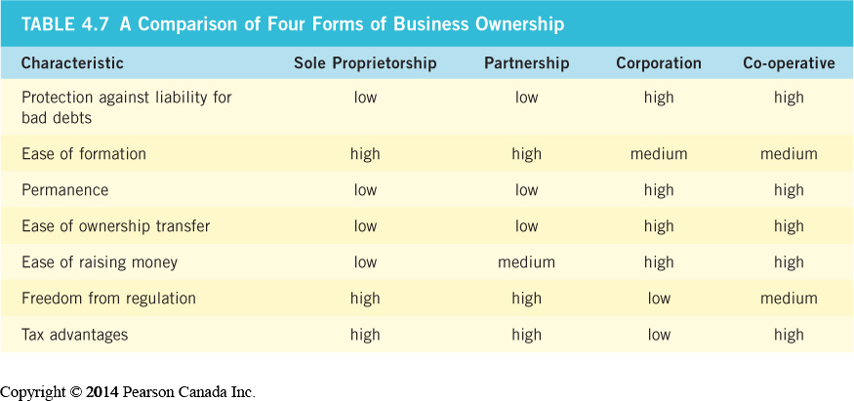
Forms of Business Organizations
(LO 4-5)
Copyright © 2014 Pearson Canada Inc.
4-<number>
Notes:
Learning Objective: 4-5

Slide 29
Success and Failure in Small Business
(LO 4-6)
Reasons for Success
  Hard work, drive, and dedication
  Market demand for product or service
  Managerial competence
  Luck
Copyright © 2014 Pearson Canada Inc.
4-<number>
Notes:
Learning Objective: 4-6
Activities
Application Exercises #3

Slide 30
Success and Failure in Small Business
(LO 4-6)
Reasons for Failure
Managerial Incompetence
Neglect
Weak Control Systems
Insufficient Capital
Copyright © 2014 Pearson Canada Inc.
4-<number>
Notes:
Learning Objective: 4-6
Figure 4.8
Activities
Application Exercises #3

